Slide 1






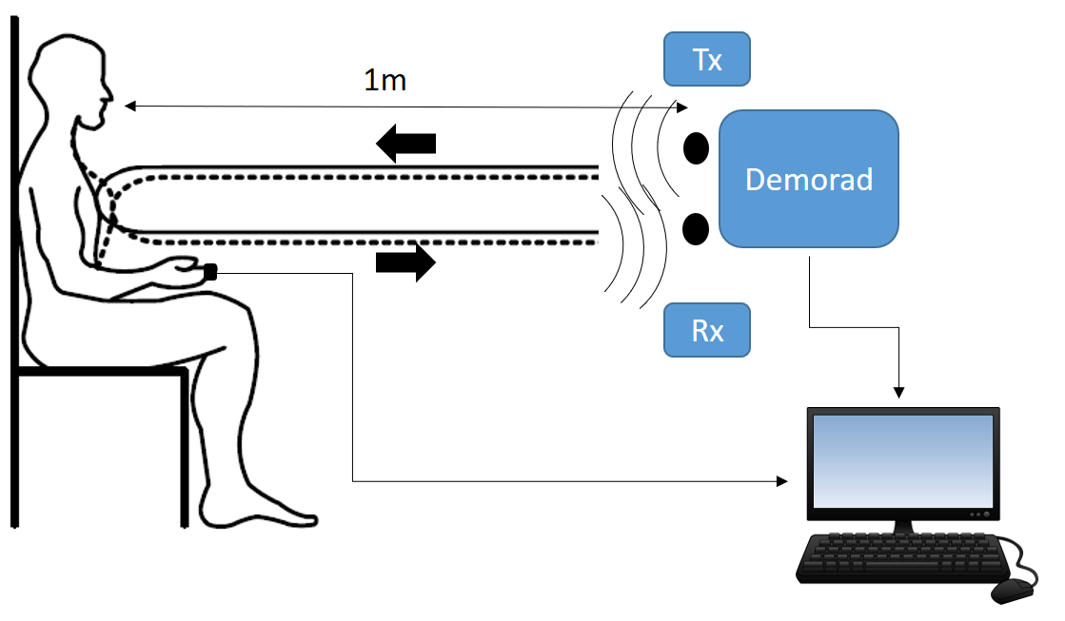

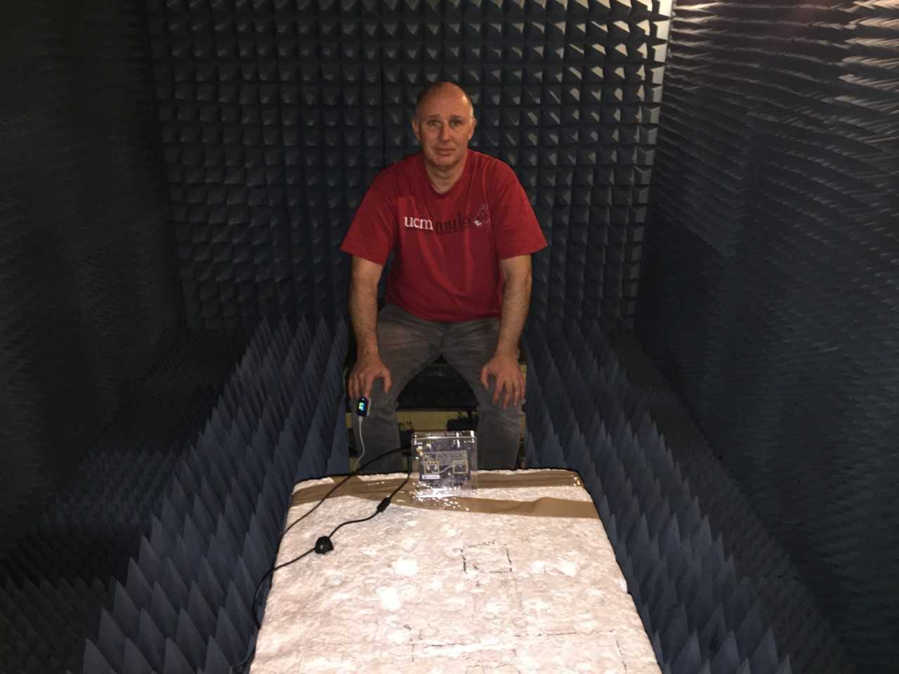
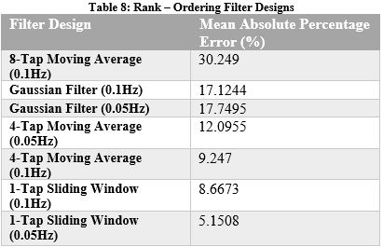
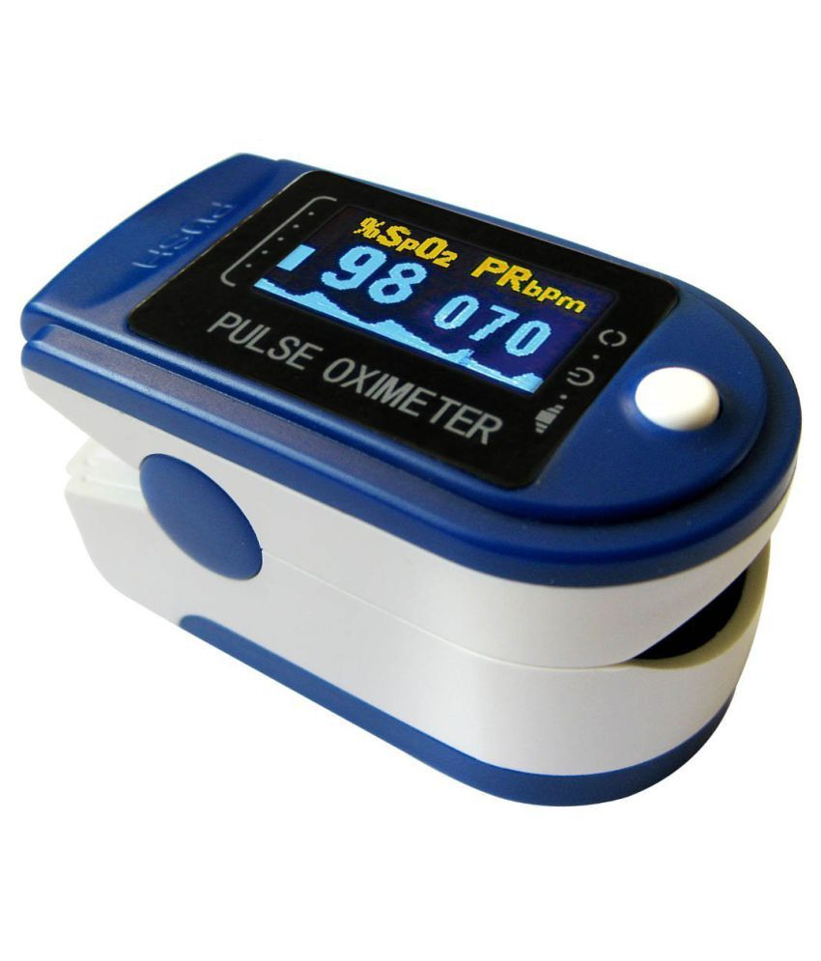
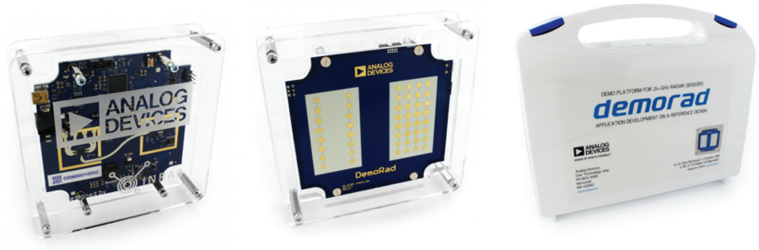
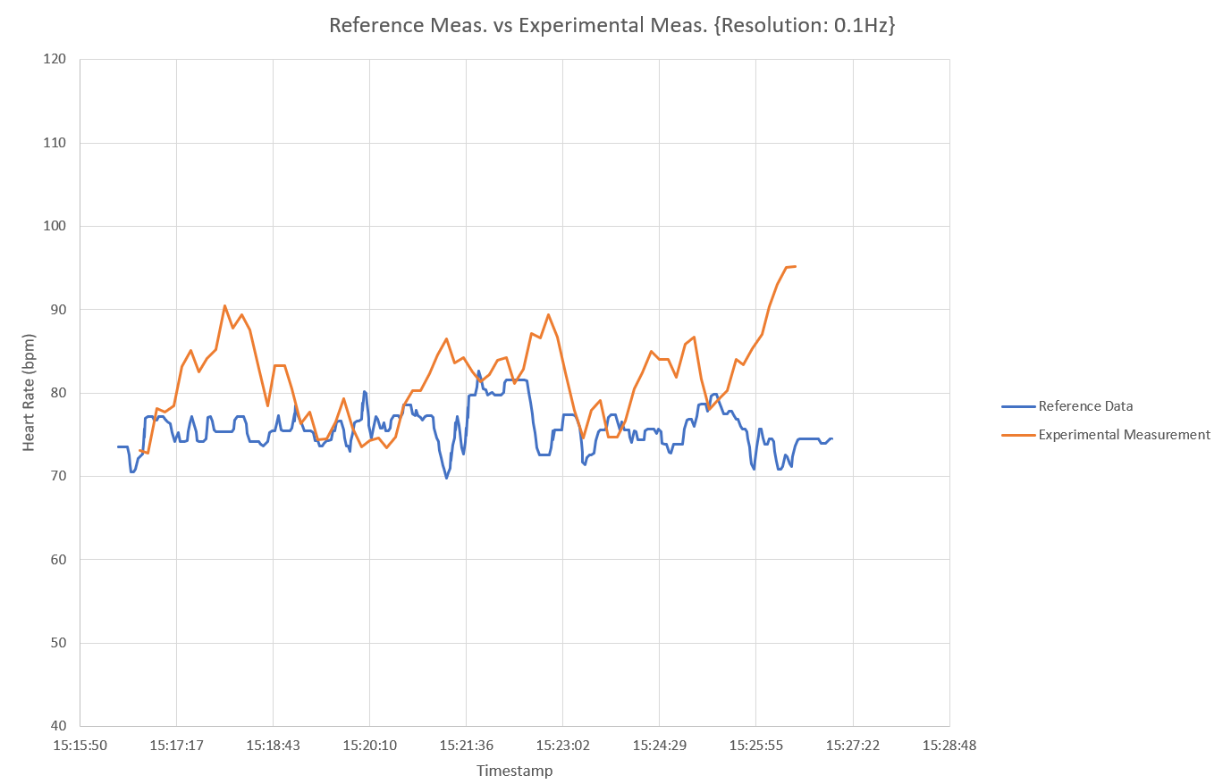
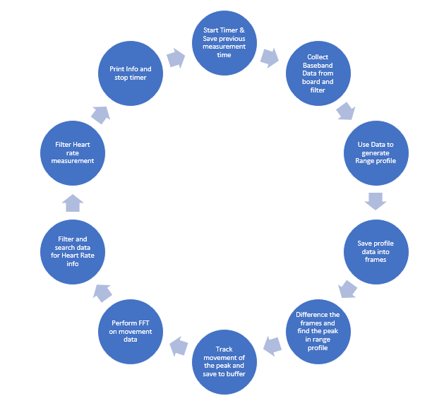
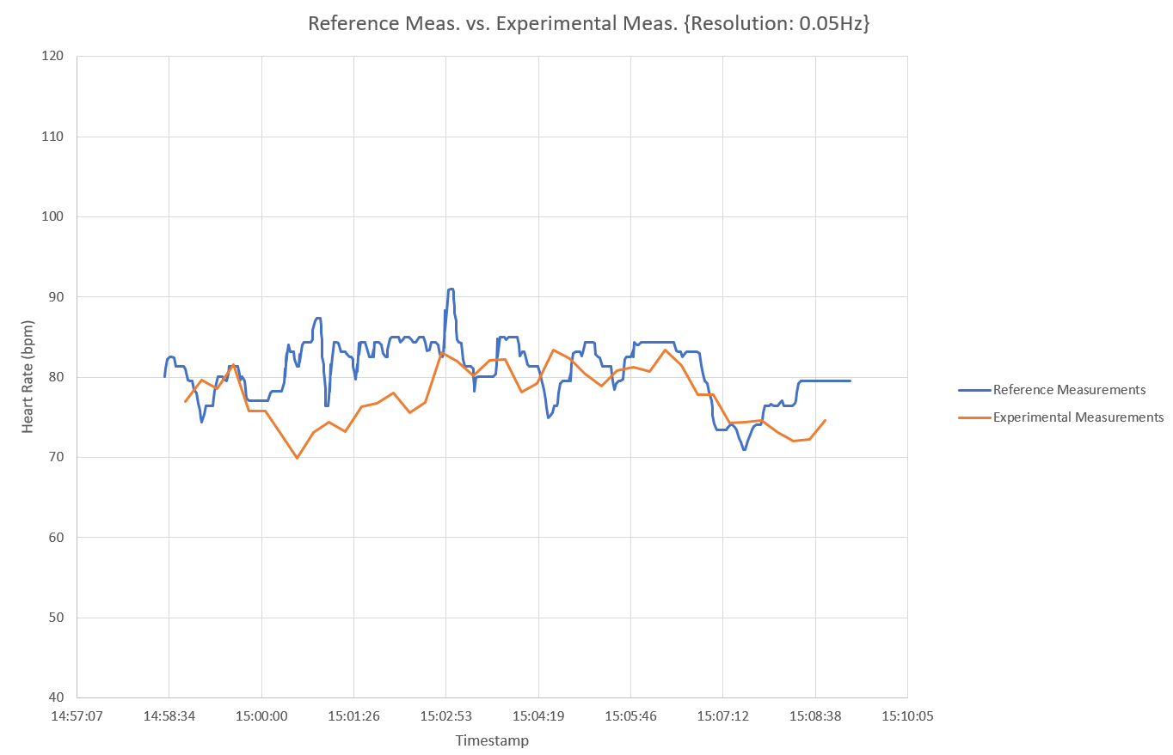





An Application of 24GHz RADAR for Contactless Heart Rate Monitoring
Oisin Watkins
LM118 Electronic & Computer Engineering – General Stream
Introduction
This project was specified in consultation with and partly funded by the Automated Transport & Safety department of Analog Devices, Inc. Limerick, with a large portion of the testing being conducted on University of Limerick campus. The goal is:
Use the ADI Demorad 24GHz RADAR platform to measure cardiopulmonary movement at a distance of 1m from the subject with an accuracy of 90% or greater
This system would find its place in intelligent vehicles, more specifically the automated emergency services contact system of intelligent vehicles.
Method
Testing Method:
In the interest of characterisation, this prototype was tested in the Anechoic chamber found in Main building, C-block, floor 0. Here a version of a Method Comparison study was performed (however the typical analysis performed on a Method Comparison Study was not appropriate for this experiment, as discussed in the results section), where the measurement taken from this prototype was compared against the “Gold Standard” SpO2 fingertip optical sensor.
Next we define Mean Absolute Percentage Error as:
And chart the MAPE of each design, ordered from worst to best:
The 1-Tap Sliding Window design, with frequency resolution set to 0.05Hz performed the best, achieving error of 5.15% (accuracy = 94.85%). Two other designs also passed the test criteria, though with marginally worse performance.
Simplified diagram of experiment setup
Aim
Write a prototype MATLAB script to control the Demorad and read Heart Rate data from it. When the prototype has been confirmed to be functional, test it in as noiseless an environment as can be found.
Using the an appropriate error metric, test whether the prototype passes the accuracy requirement outlined in the project definition.
Ideally at the end of this project one or more designs will exist which meet this accuracy requirement. These designs will go on to form the basis for the further research of this project
Dr. Bob Strunz in the Anechoic chamber during testing
Contec Pulse Oximeter; Sp02 measurement device. Used as a reference for this experiment.
Method
This section will detail both the design method and the testing method employed during the course of this project.
Design Method:
The resulting prototype from this design process will measure the distance from itself to the patient’s chest wall over time and use this to discern the patient’s heart rate. This design must therefore account for every factor contributing to the movement of the chest wall.
Results
As mentioned previously, Method Comparison Study analysis was not appropriate for this project. This is because method comparisons need data which has a wide input value range. Here, the heart rate of the subject remained in the 70-90 bpm range, meaning that a scatter-plot drawn from this data would be clustered around one set of values. Performing time-series analysis proved far more useful. From the data gathered in the experiment the maximum error, average error and standard deviation of the error were tabulated for each design. Later, each design was compared based on their Mean Absolute Percentage Error (MAPE).
Conclusion and personal reflection
As seen above, this prototype design more than achieved the accuracy requirement outlined at the beginning of the project. If this project were to be done again greater variations on test conditions would be attempted: more test subjects under different conditions (some who are deliberately slowing heart rate, others who are speeding it up, etc).
There is also a lot to be said for defining the type of experiment being carried out early on, here the data is gathered and analysed later. A more efficient approach would have been to figure out how to analyse the data immediately, then have that pre-programmed into the script. This would doubtless have saved time, but the end result would have been the same.
These are the output plots from the two best designs (1-Tap Sliding Average at 0.1Hz and 0.05Hz Resolution)
Acknowledgements
My friends and family for proof reading my report and for listening to me practicing my presentation. My supervisor Colin Fitzpatrick for providing report writing advice, my ADI co-Ordinator Padraic O’Reilly for keeping the project on track, Dr. Bob Strunz for providing the Anechoic chamber and volunteering to be the test subject and the ADI Automated Transport and Safety Design Evaluation lab for providing their support.
Main while loop of code, where data capture and signal processing in performed. Omitting code that establishes connection to board

